Slide 1
PRODUCT FILTER / SEARCH PAGE
STUDENT NAME: DIVYA.R
REGISTER NO :24BSAI123
NMID: 83F41D082B9A59CA7A14DD432749321
DEPARTMENT: B.SC ARTIFICIAL INTELLIGENCE AND MACHINE
LEARNING
COLLEGE: SRI KRISHNA ADITHYA COLLEGE OF ARTS AND SCIENCE
UNIVERSITY:BHARATHIYAR UNIVERSITY

Slide 2
PROJECT TITLE PRODUCT FILTER / SEARCH PAGE

Slide 3
AGENDA
Problem Statement
Project Overview
End Users
Tools and Technologies
Portfolio design and Layout
Features and Functionality
Results and Screenshots
Conclusion
Github Link

Slide 4
PROBLEM STATEMENT
“To design and develop a product filter and search page that allows users to quickly find items based on categories or keywords. The project focuses on dynamic filtering and efficient DOM manipulation.”

Slide 5
PROJECT OVERVIEW
“A responsive product listing page built with HTML, CSS, and JavaScript. It displays products in a clean grid layout with search and filter options. Users can search by name or filter by category, and the product list updates instantly.”

Slide 6

WHO ARE THE END USERS?
Shoppers – To search and filter products efficiently.
E-commerce websites – For displaying and managing product catalogs.
Students/Developers – To learn filtering, DOM manipulation, and responsive layouts.

Slide 7
TOOLS AND TECHNIQUES
TML – Product cards (image, title, price, category), search bar, and filter options.
CSS – Responsive grid/flexbox layout, styled product cards, smooth transitions.
JavaScript – Logic for search, filter, and dynamic DOM updates.
VS Code / CodePen – Development and live preview.

Slide 8
POTFOLIO DESIGN AND LAYOUT
Grid layout of product cards with images, titles, prices.
Search bar at the top.
Category filter buttons/checkboxes below search.
Smooth transitions when items appear/disappear.
Responsive design for desktop and mobile.
8

Slide 9
FEATURES AND FUNCTIONALITY
Search functionality to find products by name.
Category filter buttons to show/hide relevant items.
Dynamic DOM updates for smooth user experience.
Responsive product card grid.

Slide 10
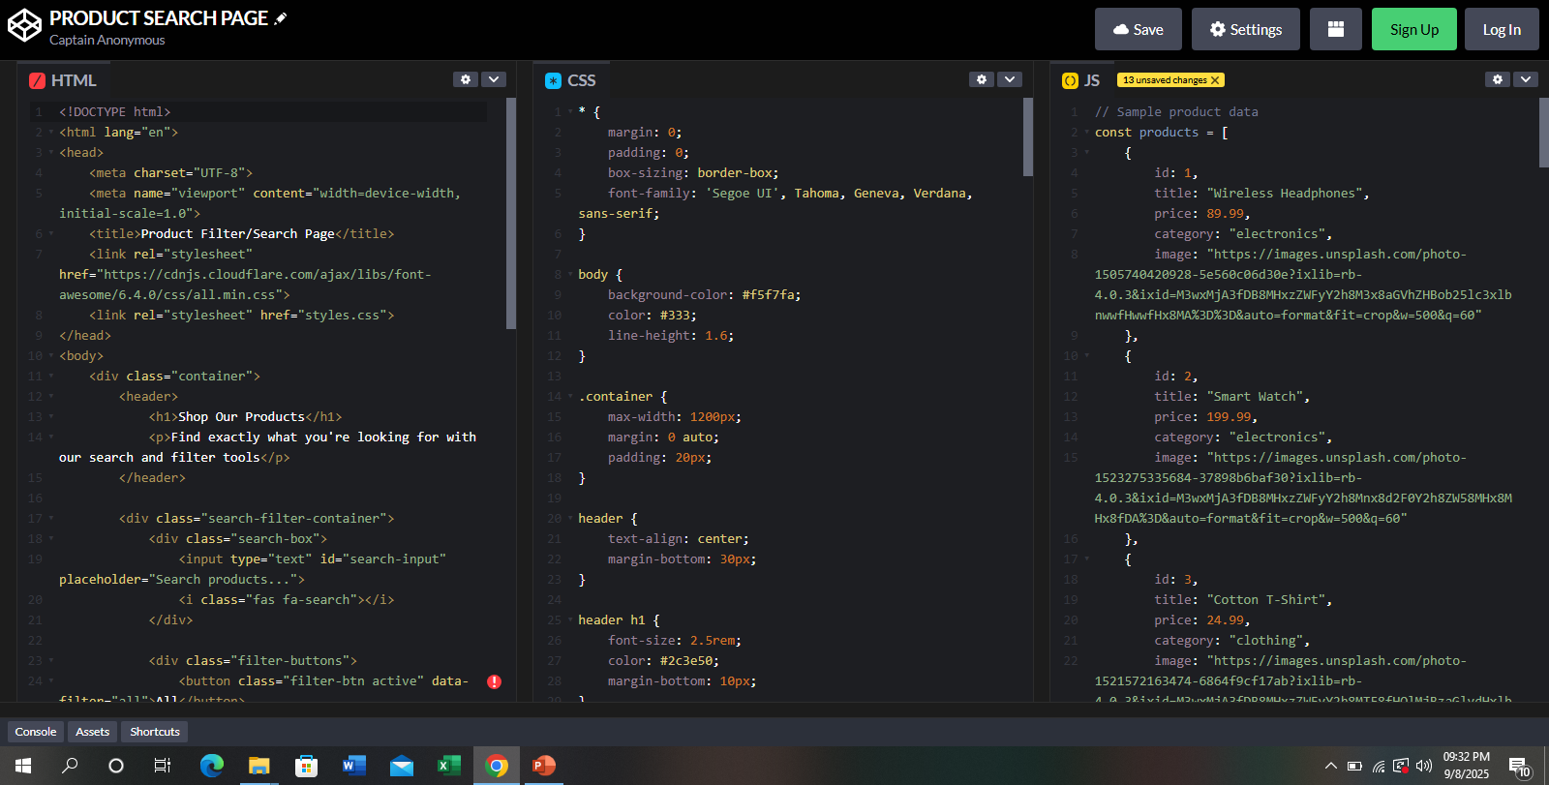
RESULTS AND SCREENSHOTS
3/21/2024 Annual Review
10

Slide 11
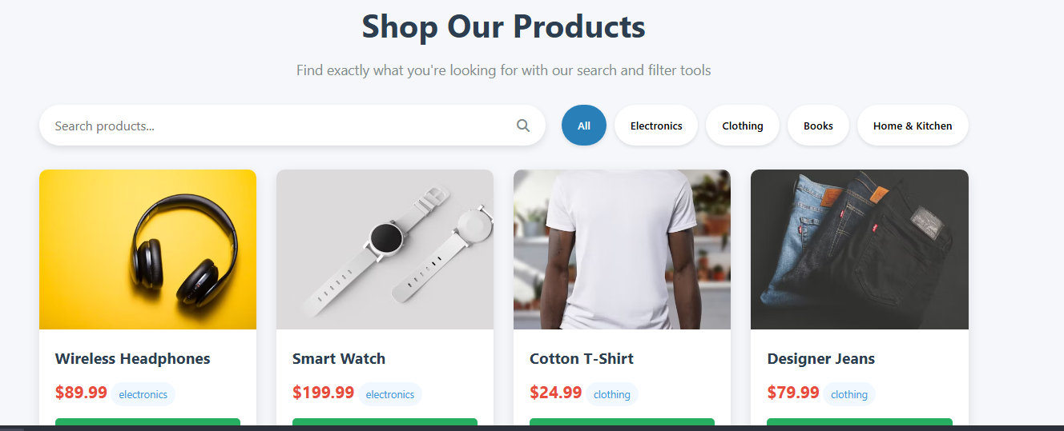

Slide 12
CONCLUSION
“Successfully built a product filter and search page using HTML, CSS, and JavaScript. The project demonstrates efficient DOM manipulation and interactive UI design. Future improvements could include: sorting by price, multiple filter combinations, and backend integration for real product data.”
12

